Slide 1

Software Architecture
Trivial i1b

Slide 2
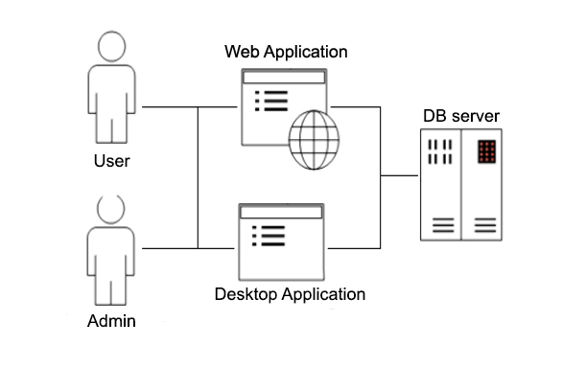
ASW Project
Notes:
The objective of this Project it’s to make a program that has two utilities, to be able to play the trivial game, and as the admin to get information about the users and the games that they play. This functionality it’s going to be the same for the two main applications the desktop one and the web. There’s going to be support of a Database to perform all the necessary persistence.

Slide 3
Objectives
Clearly defined Architecture Style
Use of Attribute Driven Design and Quality Scenarios.
Modularity (between phases, logic, interface… )
Reusability( login between the 2 and 3 part)
Usability. Easy and intuitive interfaces.
Other Quality attributes.
Notes:
The common objectives to the deliverables are:
Defined the proper architecture Style.
User the Attribute Driven Design and the Quality Scenarios.
Use modularity to separate properly phases, packages….
Reusability for example the Model of the logic and persistence on the two applications.
Usability to make easy interactions with the user.
Some other quality attributes

Slide 4
First Deliverable : PARSER
Trivial i1b

Slide 5
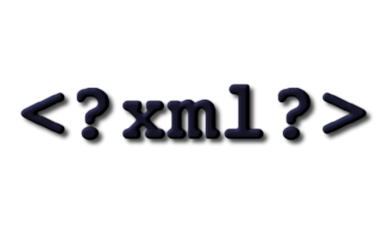
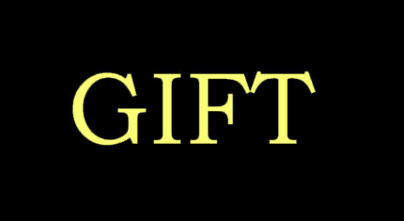


Description
Input
Intermediate format
Output
Persistence
Notes:
In this first deliverable the problem is a parser to translate the questions form one input format in our case XML or GIFT, to a JSON format that is going to be persist on a Mongo DB. For this transalation, we use an internal intermediate format.

Slide 6
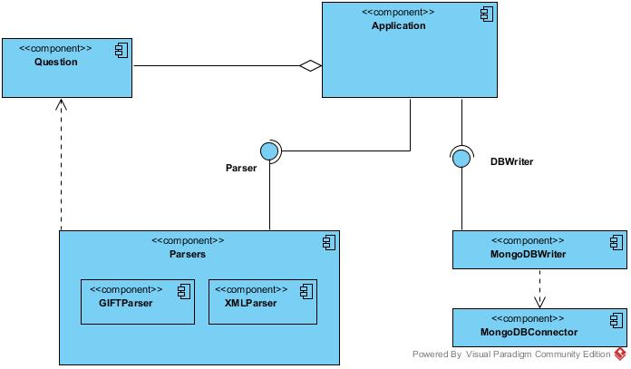
Architecture
Sequential or Batch:
Parser
Processing
Persist
Notes:
The architecture is Sequential or Batch. The execution is done linearly, always the same. It has there phases:
the Parsing is done by the Parsers, it could be from GIFT or from XML but then the processing to JSON and the persistence is done by the DBWritter, that receives a collection of questions and processes them before persist them.

Slide 7

Quality atributes
Modifiability
Scalability
Testability
Usability
Performance
Notes:
To define the quality attributes you have to consider the different stakeholders and the main points to adjust a good design. This ones are generated the specifications for example:
-Multiple input operations for faster usage.
-Multiple input formats supported and easy to add more.
-Simple commands so doesn’t require the user to learn to much before being able to work with it.

Slide 8

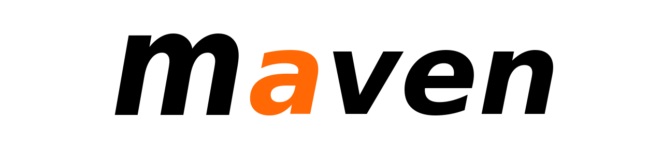

Tools and technologies
Language
Continuous integration
Version Control Flow
Persistence
Notes:
To perform this deliberation we use different tools and technologies:
We use the language Java, a continuous integration tool Maven, a Version control flow free github repository and a data base which is MongoDB.

Slide 9
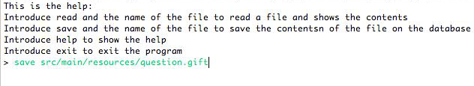
Use example
Notes:
This is the Application on use. It’s a simple console application to perform the saved of the questions on the DataBase

Slide 10
Second Deliverable : DESKTOP APPLICATION
Trivial i1b

Slide 11



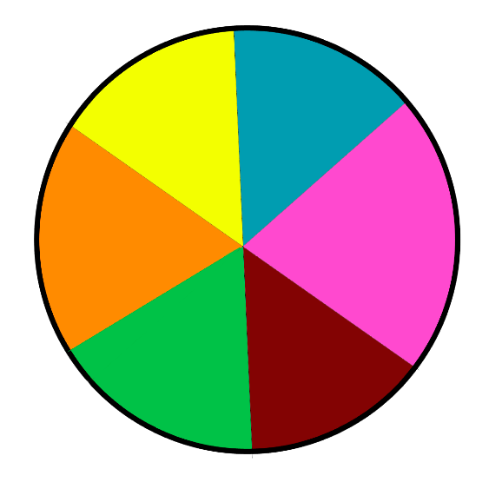

Description
Desktop Application
Register users
User
Admin
Notes:
This second deliverable its a desktop application to play Trivial. The principal restrictions are that the users have to be registered to play and the admin has access to all the statistics of the games and users.

Slide 12
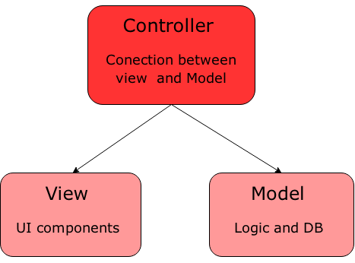
Architecture
Model-View-Controller
Notes:
In this deliverable we fulfil the approach of a MVC. There are three main different parts.
The model that contains the business logic and the records the status. It's independent from the status and the different views.
The controller which is uncharged of processing the events of the players and the proper actions.
And the last one the views that are showing the contents of the model.

Slide 13
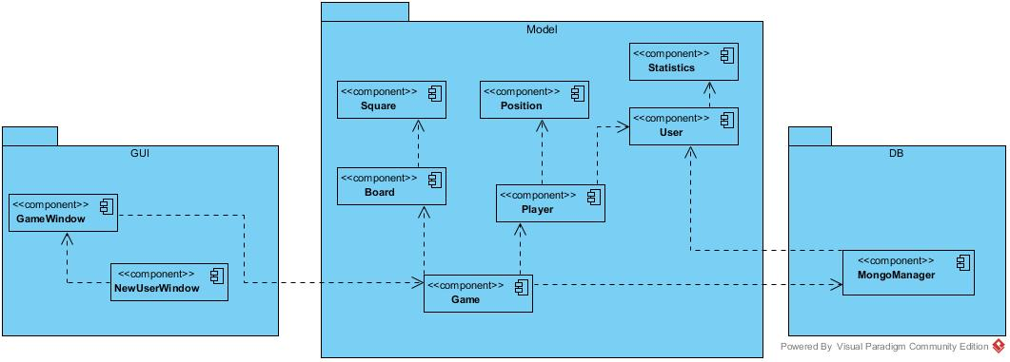
Architecture
Notes:
In our case, this is the application of the MVC. We have there differentiated modules. The Persistence with the connections to Mongo DB, here it’s also included the first deliverable. The business logic that it’s the Model package and the Views that are on the GUI package.

Slide 14
Quality atributes
Security
Confidentiality
Adaptability
Modifiability
Reusability
Notes:
The previous quality attributes are maintained and also added some other ones.
-Look & feel adaptable during the execution in some windows.
-User-friendly interface thanks to the similarities to the classic game.
-The Logic and business should be reusable to future applications.
-Security and confidentiality to the information of the users. That should be correctly recorded on the DB.

Slide 15






Tools and technologies
Previous ones (Java, Continuous integration, Version Control Flow, Persistence)
Interface plugins.
Testing
Testing and construction
Windows Builder
Notes:
In this deliverable we used previous tools as Java, Maven, github and mongoDB
But we also used the eclipse Plugging to create Interfaces Windows Builder, the testing tool Cucumber and for testing and construction Travis.

Slide 16
VIDEO DE ACCION

Slide 17
Third Deliverable : WEB APPLICATION
Trivial i1b

Slide 18

Description
Web Application
Register users
User
Admin
Notes:
The third deliverable is the same application but instead it’s a Web Application. It has the same functionality. Register users to play and an admin with statistics information.

Slide 19
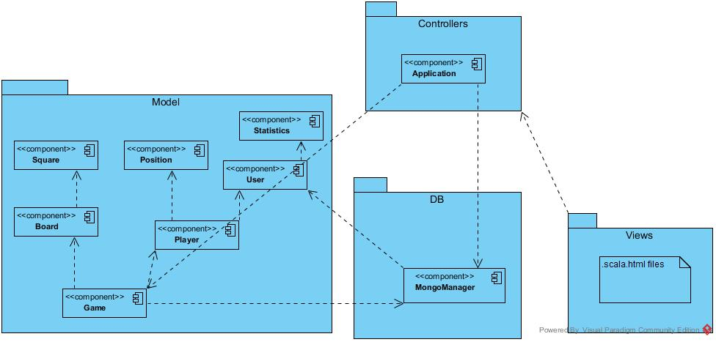
Architecture
Notes:
In this case the architecture is the Model-View-Controller exactly as the second one. The Controller it’s the Application created on the play project. The Model it’s exactly the same with the DB, cause thanks to the reusability we can reuse it. And the views in this case are scala.html files that we use with Play.

Slide 20
Quality atributes
Reusability
Usability
Availability
Security
Notes:
In this case we also have the previous quality attributes and some others like
-The logic and business model is reused from the second deliverable.
-The web usability is important, should be accessible and user-friendly.
-Availability of the servers, in our case the DB one.
-Security and confidentiality that is much more delicate on the web.

Slide 21


Tools and technologies
Previous ones (Java, Continuous integration, Version Control Flow, Persistence Testing and construction)
Framework(PLAY)
DB Server
Notes:
For this deliverable we use all the previous tools as Maven, github, mongo… And in order to do our application a web application we use the Play Framework. We also uploaded the DB to an online server called MongoLab. So the user don’t have to open de local db and the users could play for any computer on the net.

Slide 22
Simulation of the third Application on use
Notes:
In our case, we weren’t able to do a prototype completely useful. We were able to Login and register users to provide a control of the user access to the game. And the exclusive user of the admin to the stadistics. But the board representation does not work. We have the Play Project with all the routes and the controllers and the HTML views. After an effort trying to fight with Play and our short knowledge of JavaScript, we were not able to represent on the board view the actual situation of the Game.

Slide 23
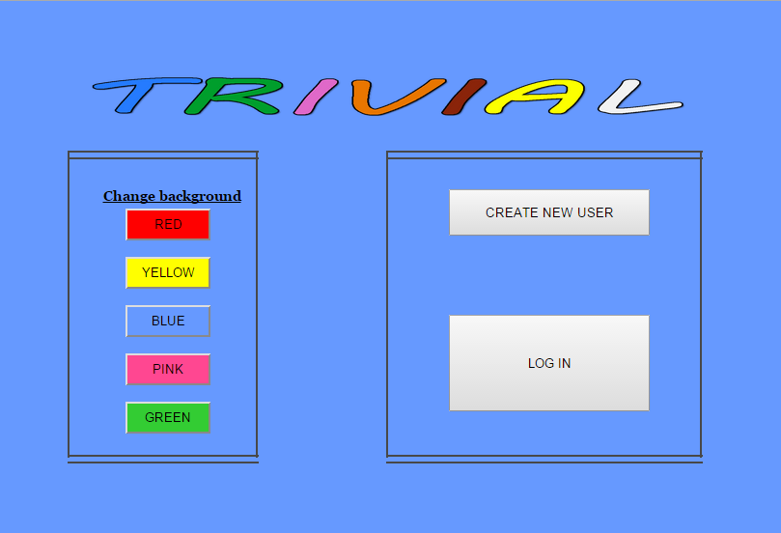
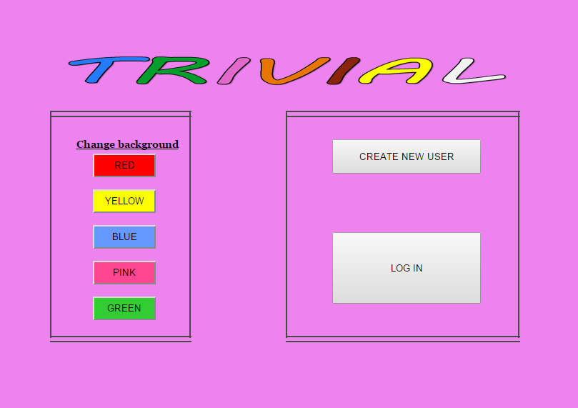
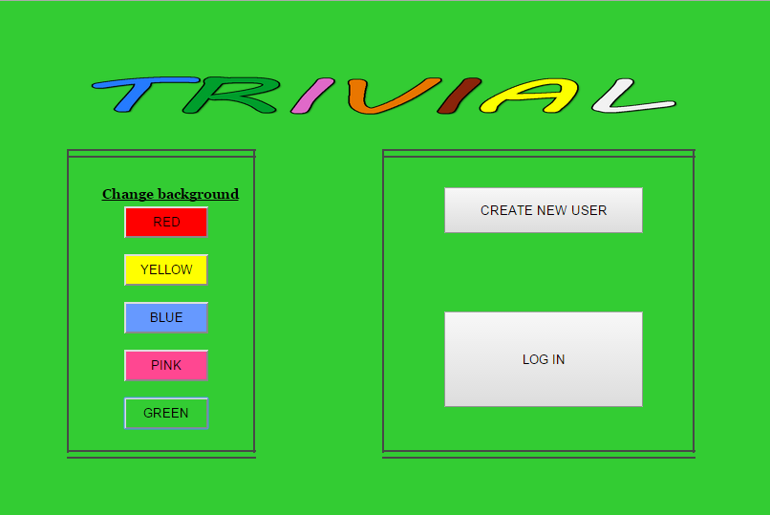
Notes:
The idea to use our application starts with this window. It’s the one that appears when you deploy the correct URL. In this window you could change the background colour with the buttons placed on the left. On the right you have two options. If you’re a register user, you could click on login. If you’re not a register user you create a new user.

Slide 24
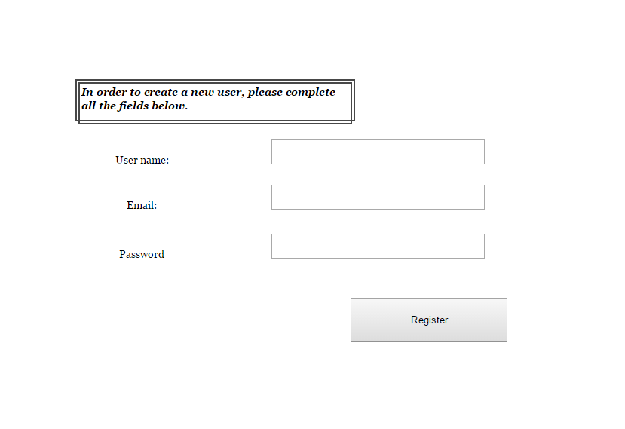
Notes:
If you have never played the first thing it’s to create a new user. In this window you should fulfil the user name, email and password. After that you click Register, and you’re ready to login and start playing.

Slide 25
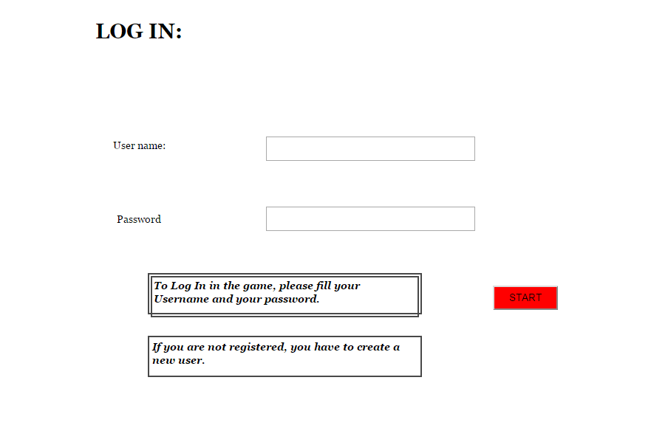
Notes:
If you’re a user you came to the login window and after introduce you’re user name and password you click the Start button and you could Access to the board Game.

Slide 26
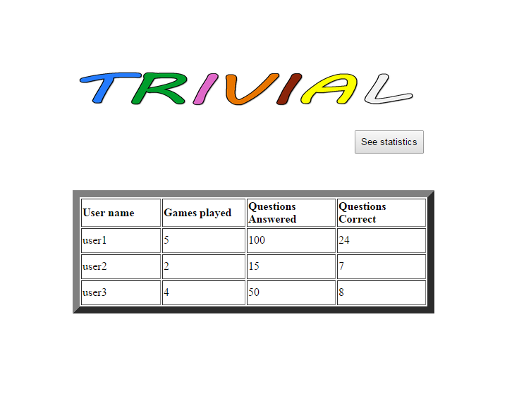
Notes:
If the login is done with the admin role, the window that appears it’s this one. That shows the statistics of the games and questions for the different users.

Slide 27
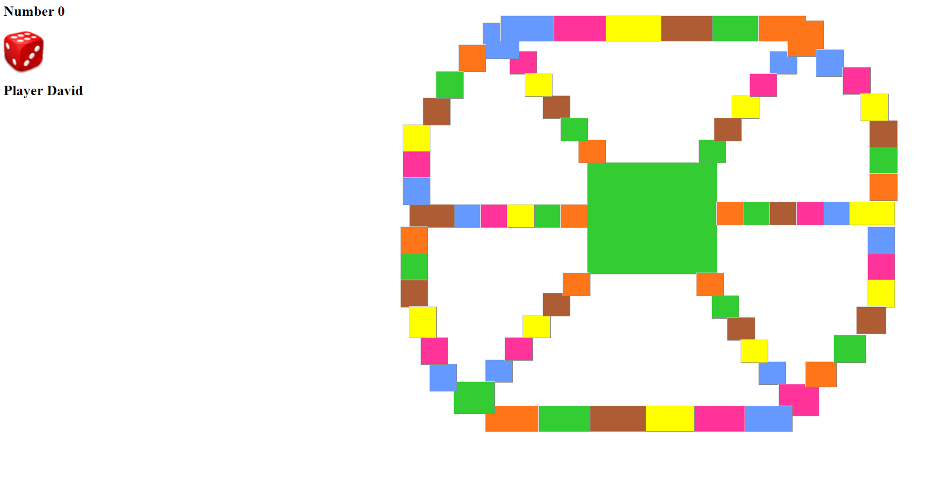
Notes:
The last window is the board. This is the one that does not work properly. In this one the user should be represented in the position where it starts, that it’s randomly generated. Then the Die is rolled and the possible movements are activated. The user click on one of them and the User piece is moved. The user is winning pieces where it answer correctly one question of each colour. When that happens he could move to the centre of the board. And the last question is generated. It’s a random question so it could be of the six different categories. If he answer correctly he wins the Game.

Slide 28
Questions ?
Trivial i1b

